Slide 1
IOT
Hands-On 4

Slide 2
Hands-On #4
Goals:
Create client session to HiveMQ broker (public server)
Create continuous subscriber session
Implement simple event handler based on sensor’s data
Control white-cube devices/emulators

Slide 3
Steps TODO:
Create client to broker server
Run cubes emulators
Monitor your cube set by http://hivemq.com/demos/websocket-client/
Create continuous subscribe session to monitor your cubes group (by web-browser and python script)
Define event handler for each cube from set (Button, DHT, Light, Reed, Relay)
Create interactions with your cubes group according to tests set (1 - 3)
Create short word report, upload to MOODLE as Assignment #2

Slide 4
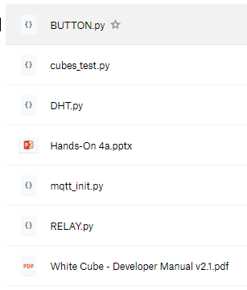
TODO
Use next example file:
Cubes_test.py

Slide 5
Test 1
Goal: collect data from DHT
Steps to proceed:
create client
run your device (emulator)
start monitoring for 10 min (collect 20 data samples)
(optional task):
parse messages from DHT and create excel file with temperature and humidity curves

Slide 6
Test 2
Goal: control RELAY
Steps to proceed:
create client
run your device (emulator)
Send ON command, observe change status on device (emulator)
Send OFF command, observe change status on device (emulator)

Slide 7
Test 3
Goal: recognize event from BUTTON (push button)
Steps to proceed:
create client
run your device (emulator)
Push button, observe instant event
Create appropriate event detector method
Use RELAY as pair for BUTTON (alter RELAY state all time when the BUTTON is pushed)

Slide 8
Test 4 (only in class)
Goal: recognize event from REED (applied magnetic field detector)
Steps to proceed:
create client
recognize your device
Use magnet for changing REED state
Create appropriate event detector method
Use RELAY as pair for REED (alter RELAY state all time when magnetic field applied to REED)

Slide 9
Test 5 (only in class)
Goal: recognize event from LIGHT (LDR - Light Dependent Resistors)
Steps to proceed:
create client
recognize your device
Observe data in default state
Change light intensity, observe change
Use RELAY as pair for LIGHT(change RELAY state to ON when light intensity under threshold=100, and OFF when above)

